Slide 1
Detection of Epileptic Seizures in a domestic environment …and turning it into a useable consumer device
Graham Jones, CfAI
05 August 2020

Slide 2
Agenda
Epilepsy and Seizures
Project Motivation and Objectives
Seizure Detection Techniques
Wrist Worn Accelerometer
Video Game Depth Camera
Deterministic Video Image Analysis
Machine Learning Video Image Analysis
Smart Watches
Proof of Concept to Workable System
Alarm System Requirements
Implementation Challenges
End User Experiences
What Next?
Questions?

Slide 3
Epilepsy and Seizures (1)
From World Health Organisation: https://www.who.int/mental_health/mhgap/epi_slides.pdf

Slide 4
Epilepsy and Seizures (2)
Types of Seizure:
Tonic – Stiffening of muscles
Tonic-Clonic – Stiffening of muscles, followed by shaking.
Myoclonic – Sudden jerks
Atonic – sudden relaxation of muscles – drops to floor.
Absence
Risks associated with seizures:
During some seizures, people can injure themselves, develop other medical problems, or have a life-threatening emergency.
The overall risk of dying for people with epilepsy is 1.6 to 3 times higher than for people without epilepsy (Epilepsy Foundation)
General advice is to call an ambulance if someone has a seizure that lasts for more than 5 minutes (NHS)

Slide 5
Project Motivation
Our Son is severely disabled, with issues including:
Autism,
Severe Learning Difficulties
Epilepsy.
We set up a video monitor to check on him:
One morning we noticed he looked odd on the video monitor.
He was having a serious seizure – we had to resuscitate him
Blue light trip to the hospital
The only reason we went to check on him is that we happened to look at the video monitor.
What we really needed was something to go ‘beep’ to make us look up….
Commercial seizure detectors did exist at the time (2013), but they all relied on a pressure sensor in the bed….And Benjamin insisted on sleeping on the floor….
so I would have to make my own….

Slide 6
Project Objectives
Monitor Benjamin in his bedroom (he is never alone anywhere else).
Preferably Non-contact sensing as he is autistic and unlikely to tolerate being connected to things.
Raise an alarm to prompt us to check on him.
Later, as the project matured I extended it to being Open Source and freely available to other people who might benefit from it, with the intention of making the lowest cost seizure detector possible (http://openseizuredetector.org.uk)

Slide 7
Seizure Detection Techniques

Slide 8
Seizure Symptoms
Unusual brain activity
Movement of Limbs (3-8 Hz)
Falls
Breathing Rate
Heart Rate (?)
Skin Conductivity
‘Odd’ Behaviour
…..maybe more

Slide 9
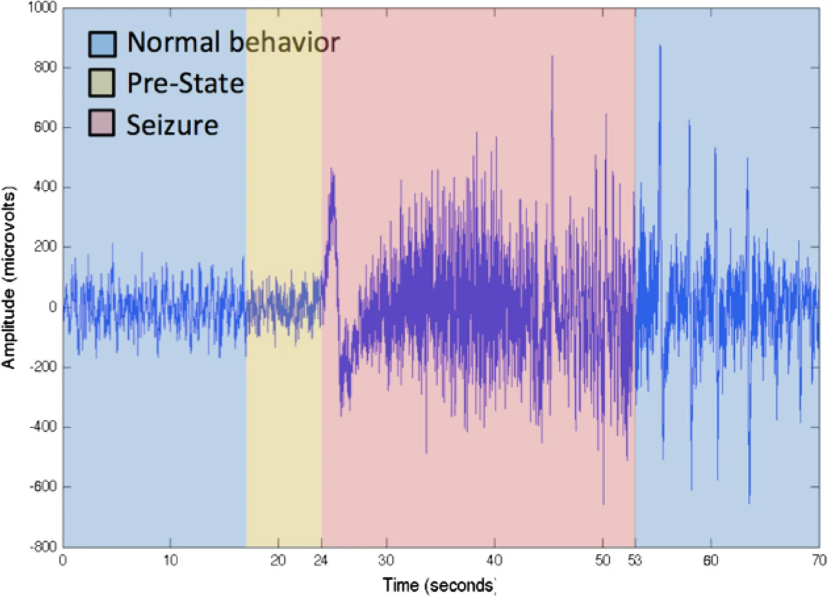
Methods Available at the Time (2013)
Electroencephalogram (EEG) – measurement of electrical activity in the brain (from Alotaiby et. al. 2014)
19 electrodes attached to the head, so not practical in the home.
Bed monitor – detects vibration and possibly moisture.
But Benjamin slept on the floor, so no use.

Slide 10
Accelerometer

Slide 11
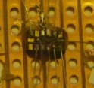
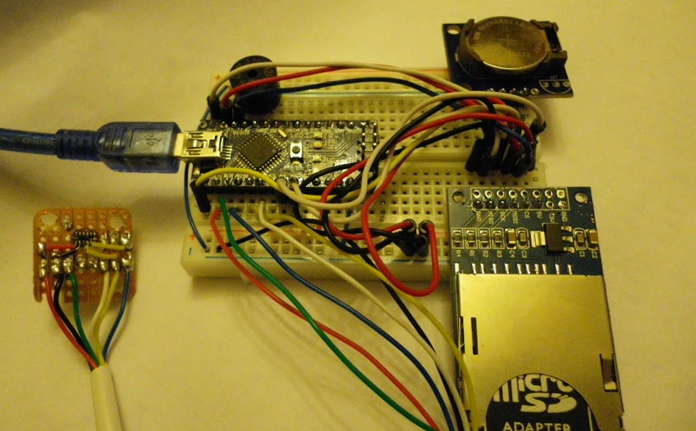
Wrist Worn Accelerometer (1)
You can buy tiny accelerometers on a chip (e.g ADXL345 – 4mg/LSB, over 100Hz sample frequency, data buffer with interrupt driven output)
but it is a SMD so a pain to connect!
We expect the seizure movement to be in the 3-8Hz range.
Sample at 25Hz or greater means we can detect up to 12.5Hz
Shoehorn an integer based FFT library onto a well known microcontroller
Look for an excess of movement in the 3-8Hz range compared to the rest of the spectrum.
Add a buzzer, clock and memory card for logging….Very first prototype shown below.

Slide 12
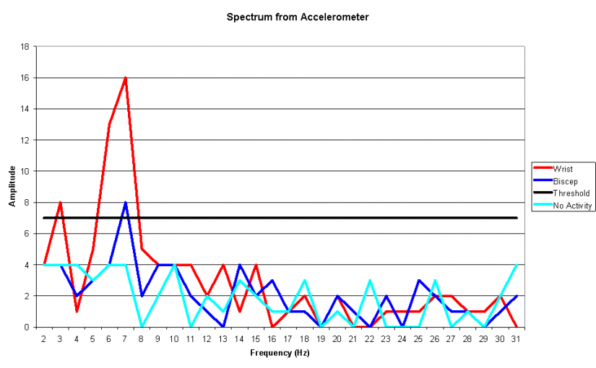
Wrist Worn Accelerometer (2)
Surprisingly, it worked pretty well – can clearly detect ‘seizure like’ movements when worn on the wrist. Could also work on a bicep, but signal less distinct.
But very bulky and flattened a 9V battery in a few hours, so not practical.
Tried attaching an accelerometer to a floor board, but it was an abysmal failure!
We did go back to the wrist worn accelerometer in the end though – more later…..

Slide 13
Microsoft Kinect Video Game Controller

Slide 14
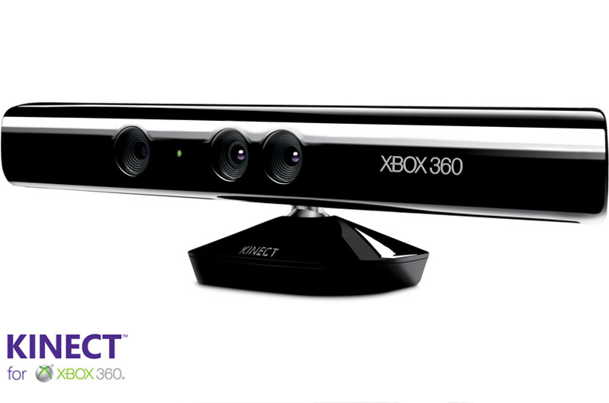
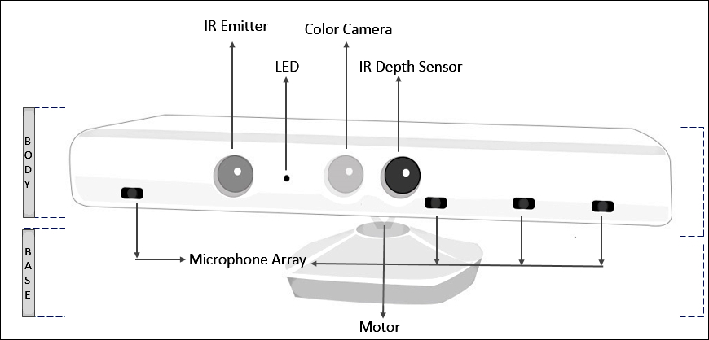
Video Game Depth Camera (1)
Because of Benjamin’s Autism, and refusal to sleep in a bed, we really wanted a non-contact way of monitoring him.
The Microsoft Kinect sensor is rather clever in that it contains a Depth Camera where the pixel values are the distance of the object at that position from the camera.
It works by projecting an array of NIR dots into the room, which are detected by a CMOS camera that is offset from the light source.
Some knowledge of the geometry and shape of the array of dots means you can calculate distance.
Fortunately the Kinect Sensor did all the geometry, and there is an open source driver for it, so I just received a series of images where the pixel values are distance from the camera.

Slide 15
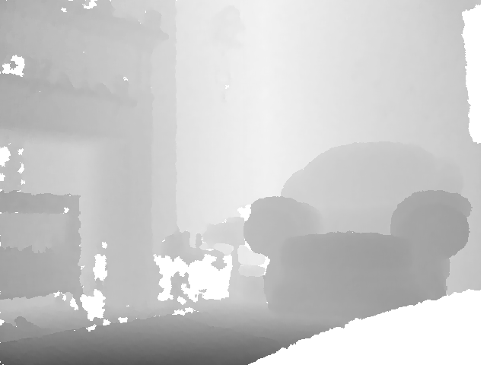

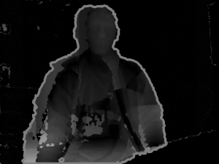
Video Game Depth Camera (2)
Compare Depth Camera frames to measure velocity of features in the room
Image Processing Approach is to collect a series of images and process them to extract a measure of the amount of movement of the test subject:
Background Image
With Test Subject
Subtract Background to give ‘current’ image of subject.
Pick out the largest bright area, which we assume is Benjamin, and calculate its intensity – this is a measure of how much he is moving.
Record this into a time series for analysis.
For each frame, subtract rolling average of ‘current’ images, and amplify the differences – small movements show up clearly.

Slide 16
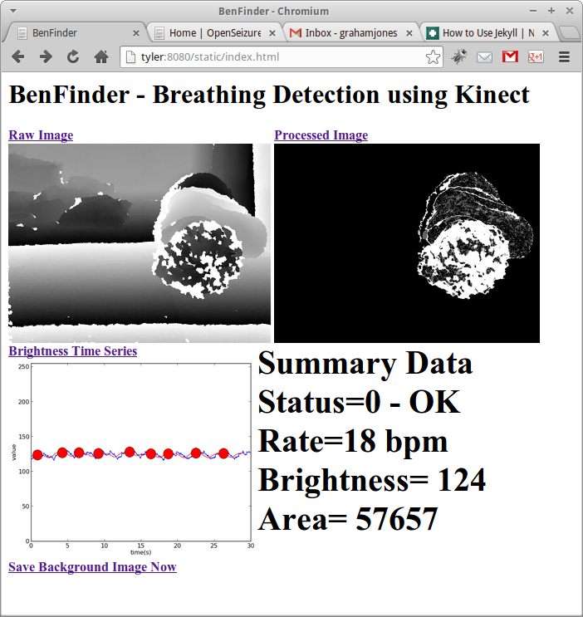
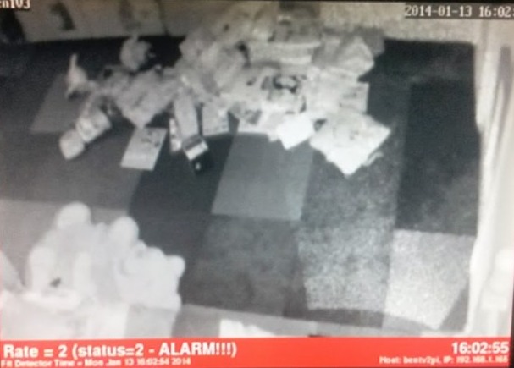
Video Game Depth Camera (3)
Develop the image analysis calculation route to
Record the total brightness of the resulting image for each frame.
Look for peaks in the brightness time series.
Interpret peaks as breaths to give us a breathing rate in breaths per minute.
Use a raspberry Pi to display the images and analysis results in our bedroom.
It is not a seizure detector – frame rate is too slow to detect 3-8Hz movement , but it is an apnoea ‘lack of breathing’ detector which provided us with some peace of mind.
First working detection system ☺.
We used this for a couple of years, but it was too temperamental to suggest other people installed it.

Slide 17
Video Image Processing

Slide 18
Video Image Processing
The Kinect based system was nice in that it confirmed Benjamin was breathing (comforting to know!), but it would not detect a seizure, and was quite power hungry (>30W).
We have a digital video camera in his bedroom, so can we process the images from that to identify seizure-like movement?
Tried two different approaches at different times:
“Deterministic” image analysis of video frames to track features and deduce movement.
A machine learning (neural network) approach to train a model to recognise ‘normal’ and ‘odd’ postures, where ‘odd’ ones could be seizure-like behaviour.
The next slide has some flashing images – you may want to look away….

Slide 19
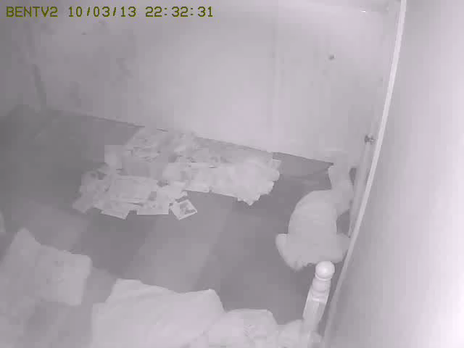
Deterministic Image Analysis
Collect a video frame
Identify ‘interesting’ features in the frame.
Track those features in subsequent frames to determine their speed
Feed the calculated speeds into a Fourier Transform to get frequency of movement – and see if that is ‘seizure like’
Videos below use different thickness circles to highlight areas of movement at different frequencies. The computer generated ‘test card’ one looks like a promising start – it is detecting higher frequencies near the faster moving blobs, but the real video is just measuring noise…..
Also tried attaching reflective markers onto Benjamin’s clothes, but not much more successful…And it was very CPU intensive…
Abandoned! ☹

Slide 20
Machine Learning Video Analysis (1)
Sandie noticed that when Benjamin is about to have a seizure, he will adopt an unusual pose – kneeling up looking to one side, getting up onto his hands and knees, waving arms...
If we could detect these ‘odd’ poses we might be able to detect some of his less serious seizures that do not result in sustained regular shaking.
…and I had just read a book about using neural networks to do image processing.
The idea was:
Collect lots of ‘normal’ pose images.
Collect as many ‘odd’ pose images as possible, and categorise them manually.
Train a neural network to look at an image from Benjamin’s camera and classify it as ‘Benjamin not Present’, ‘Normal’ or ‘Odd’.

Slide 21
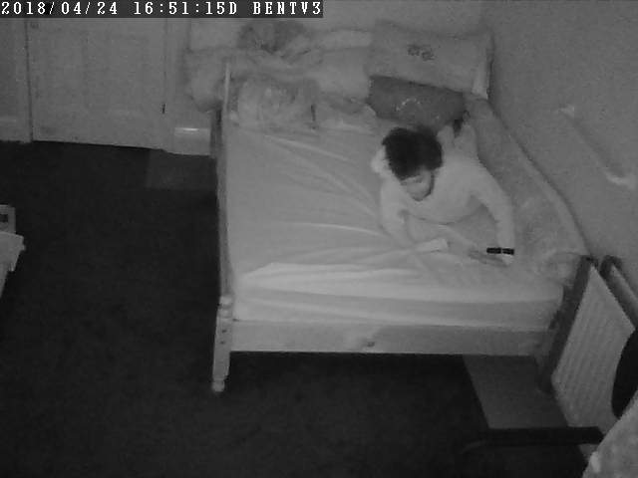
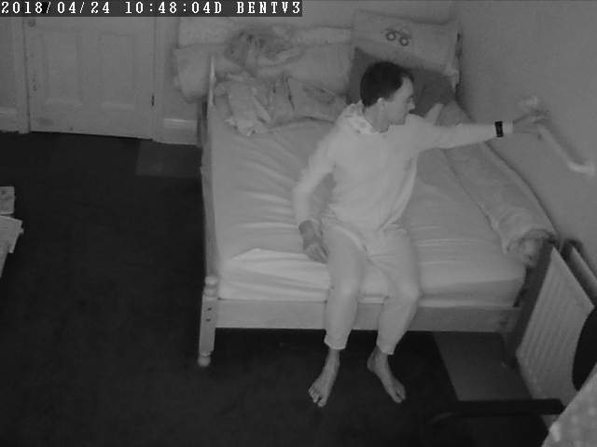
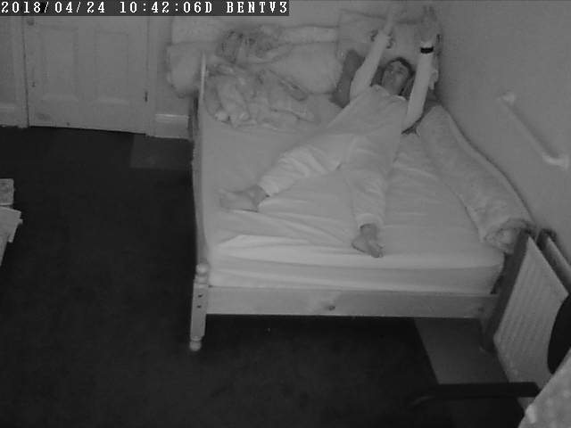
Machine Learning Video Analysis (2)
Collecting images from the video camera was easy, but classifying manually to find enough ‘odd’ ones to train a model was difficult and tedious.
So I dressed in Benjamin’s favourite Pudsey Bear sleepsuit and demonstrated a lot of ‘odd’ poses for the camera…..
There were a few problems:
The neural network was not detailed enough – I successfully taught it that Benjamin is ‘Normal’ and Graham is ‘Odd’!
Benjamin started to do the ‘odd’ behaviours when there was nothing wrong with him.
It would be very Benjamin specific, so not much use for anyone else.
Abandoned! ☹
Genuine ‘odd’ image
Simulated ‘odd’ images

Slide 22
Smart Watches

Slide 23
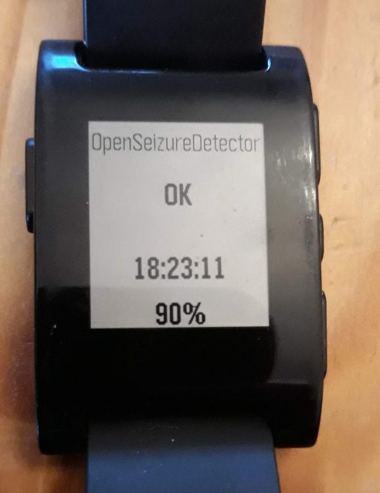
SmartWatches (1)
The Invention of the Pebble Smart Watch changed things.
It had the required hardware (accelerometer, microcontroller, Bluetooth radio, battery).
And most importantly the manufacturer gave away the Software Development Kit so you can write your own software for it….and you programme it in C ☺.
So set about implementing the accelerometer based seizure detection algorithm on it, in the hope we can train Benjamin to wear it.
Display
Accelerometer
Microcontroller
Bluetooth Radio
Push Buttons
Battery
Vibration Motor

Slide 24
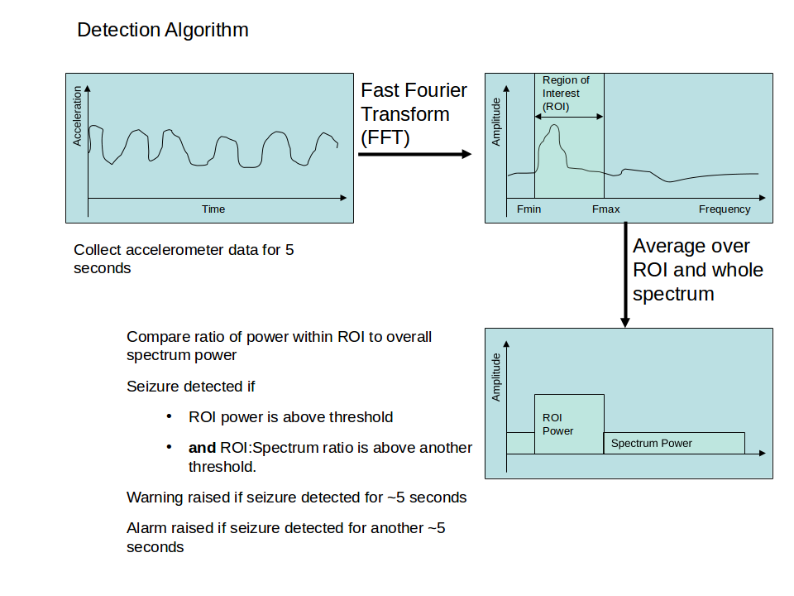
Seizure Detection Algorithm
Collect accelerometer data (at 25 Hz) for 5 seconds.
25Hz sample rate means we can detect up to 12.5 Hz, which seems to be high enough for human movement.

Slide 25
Does it Work?
The results were surprisingly good – had expected to have to develop the algorithm to maybe look at shape of spectrum, but the crude bandpass approach in previous slide seems to work ok.
Issues are:
It only detects tonic-clonic seizures that result in shaking of the arm – if the arm does not shake (because it is a partial seizure) or because it is trapped under the body, there will be no alarm.
It will generate false alarms – brushing teeth, touch typing, touching moving car bodywork all generates vibration in the ‘seizure like’ range. We get of the order 1 false alarm per day, depending on what Benjamin is doing.
The Pebble watch only does integer arithmetic, so everything is fixed point.
Battery usage is a challenge, so minimising CPU use by using simplifying assumptions which are not exactly correct mathematically..
Fitbit bought out Pebble, and promptly shut down manufacture ☹.
So now use Garmin watches which also allow abnormal heart rate alarms to be generated – and we can get raw data off them because of use of BLE.

Slide 26
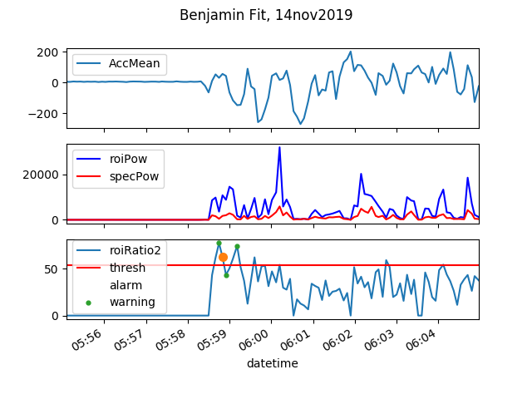
Example Data from a Real Seizure

Slide 27
From Proof-of-Concept to Deployable System

Slide 28
System Requirements
Demonstrated detection reliability.
Acceptable false alarm rate.
Battery Life > 12 hours.
Self-Diagnosis of Faults, and warn user of fault conditions.
Reliable method of notifying carers
Ability to mute alarms if doing an activity that will generate false alarms.
Log data for future analysis if necessary.
Easy (enough) to get software onto device.
Ability for users to adjust settings to suit their use-case.
This “Boring Software Infrastructure” was the most time consuming part of the project, by a considerable margin.

Slide 29
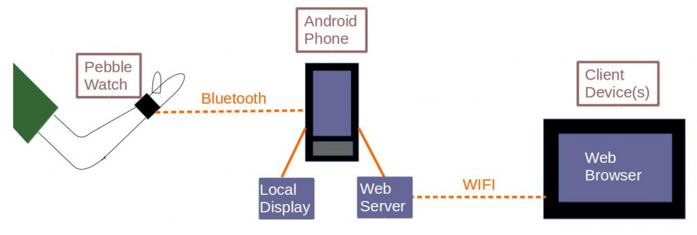
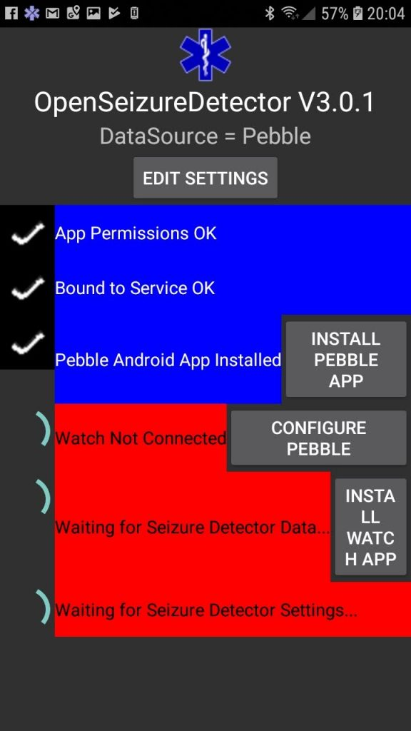
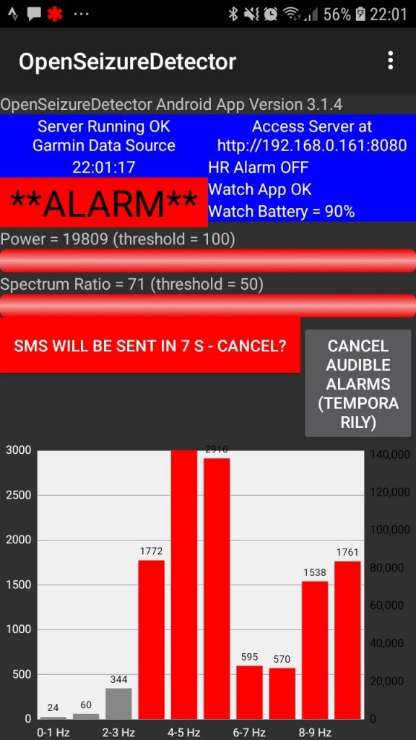
Android Based Alarm System
SMS Alerts
Self-Checking on Start-Up
Main Display in Alarm Condition

Slide 30
Software Architecture
Watch App
Phone App (Background Service)
Accelerometer Data Callback – Store Data
Timer Driven Analysis
If we have 5 seconds of data, send it to the phone.
Receive response from phone.
Update Display
Web Server (receives and presents data)
Timer Driven Fault Detection – have we received data at the expected time? If not, generate Fault condition.
Heart Rate Data Callback – Store Data
Data Received Callback – runs Seizure Detection Algorithm
Pushbutton Callback – Manage Watch UI
Check Alarms – have we detected seizure-like movement? Are we in a fault condition? Is Heart Rate within Limits?
Phone App (User Interface)
Button / Menu Callbacks to configure system.
Timer Driven:
Retrieve Data from Background Service
Display Data
Timer Driven Mute Alarms Function
Generate Alarms
Beep
Send SMS Text Message

Slide 31
Deployment Challenges
It is licenced under GPL3, so has a ‘no guarantees’ clause in the licence, but do users read that?
To make it easy for users to install, publish app on Google Play Store.
The app needs some ‘Dangerous’ permissions – to send SMS messages or make phone calls without user intervention.
It took a lot of effort to persuade Google that this was a reasonable use case so it could stay on Play Store.
The Watch app is installed manually (by copying the executable file onto the watch on a PC) because Garmin were concerned that this might be a ‘Medical Device’ so need FDA approval. I don’t have the time or energy to seek FDA approval….
Quite a few users struggle with the manual installation.

Slide 32
End User Experience
Take-up has been relatively slow
Do not ‘advertise’
But if it was too popular I would struggle to provide support.
Most people who install the app uninstall it quickly, but do not leave any comments about why.
Those that do leave reviews tend to be positive (better feedback than the commercial equivalent).
Writing documentation for a non-technical user is difficult (for me at least!).
It is all in English
But some users are now providing translations for the app text which is good – now supports several languages.

Slide 33
What Next?
Since we started on this, commercial seizure detectors have become available (e.g. Empatica Embrace, SAMi video based detector.).
I was planning on Scrapping mine when the Embrace finally arrived, but I am not keen on its approach to the alarm system infrastructure - it relies on distant servers and internet connection to generate an alarm sound at the other side of our house.
Very Low Cost Seizure Detector
There are some very cheap smart watches available now – I would like to make the lowest cost seizure detector using one of those (about £20 each) – it looks like it is possible because someone has worked out how to get software onto them – job for the winter.
Machine Learning Algorithm
Ask users to log data to my server and make a machine learning algorithm to try to improve detection reliability and reduce false alarm rate – server software about ready, but I’m concerned about holding personal information.

Slide 34
Questions or Suggestions?

Slide 35
References
https://openseizuredetector.org.uk
https://github.com/openseizuredetector
Van de Vel A. et. al. ``Non-EEG seizuredetection systems and potential SUDEP prevention : State of the art. Review and Update'', Seizure European Journal of Epilepsy, Aug. 2016, pp. 141-153
Bidwell et. al. ``Seizure reporting technologies for epilepsy treatment: A review of clinical information needs and supporting technologies'', Seizure European Journal of Epilepsy, 32 (2015), pp. 109-117
Rukasa et. al.; “Evaluation of Wearable Electronics for Epilepsy: A Systematic Review”; Electronics 2020, 9(6), 968; https://doi.org/10.3390/electronics9060968

